Slide 1
Microsoft Learn Student Ambassadors

Slide 2
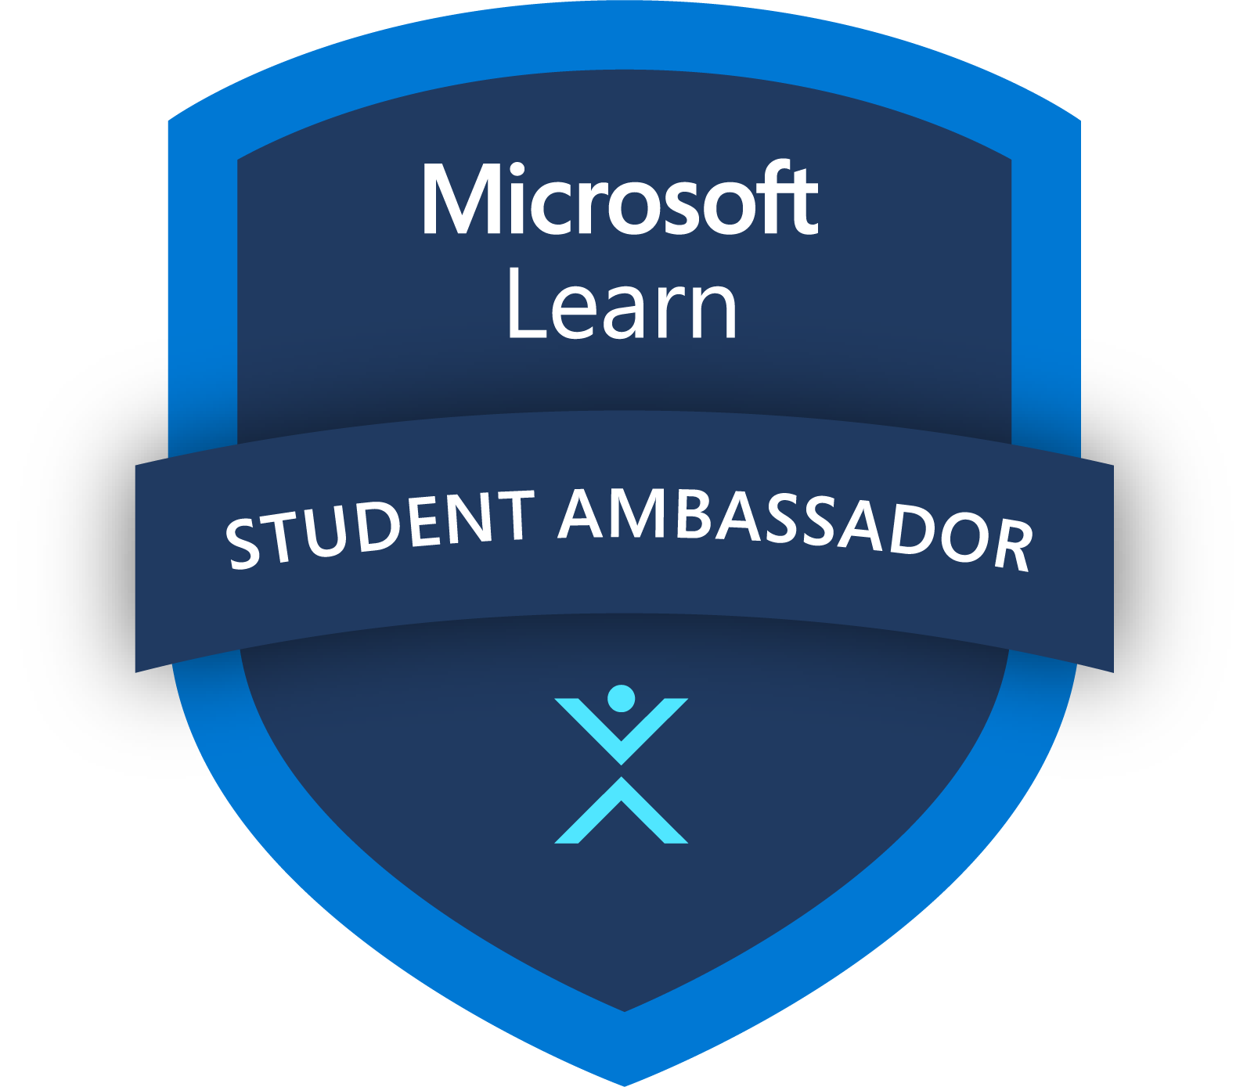
Why Join the community?
Grow as an AI entrepreneur or technical leader Unlock your potential. Gain exclusive access to cutting-edge Microsoft technologies, including Azure, Microsoft 365 with Copilot, and Visual Studio Enterprise, empowering you to build, innovate, and create the future.
Whether you’re passionate about tech, AI, or entrepreneurship, our inclusive community will empower you to unlock your potential, build valuable connections, explore cutting-edge technology, and boost your personal growth through empowering leadership opportunities and online influence.
Join a global community Connect and collaborate. Become part of a vibrant and diverse global community of tech enthusiasts, AI innovators, and aspiring entrepreneurs. Create valuable connections, share ideas, and find community within a network of peers.
Leadership opportunities that will help you make an impact Customize your journey. Develop leadership skills that align with your interests and aspirations. Empower yourself to leave a lasting impact on the tech community, while also boosting your resume, personal growth, and online influence.

Slide 3




Student Ambassadors benefits
Student Ambassadors complete activities that make contributions to the community and work to unlock additional benefits.
Key Benefits
Access to Microsoft 365
Ready-to-go presentation materials
Visual Studio Enterprise subscription
Engagement with Microsoft employees, Microsoft MVPs, and other students worldwide
$150 monthly Azure credits
Incentives for hosting events
Student Ambassadors milestone badges to highlight program accomplishments on LinkedIn profiles
Student Ambassadors Swag
Benefits may be subject to change

Slide 4

Who are the Student Ambassadors
(Based on average historical data)
4K
Student Ambassadors
Education Breakdown
Focus Area
Software Engineering 14%
Engineering – Other 12%
Other 8%
Electrical Engineering 4%
Information Systems 3%
Systems Engineering 3%
Business 2%
Cybersecurity 1%
Working toward a Bachelor of Arts
108
93%
Countries
Working toward a Master’s degree
Computer Science
53%
1.7K
6%
Universities
Working toward a PhD
1%
Notes:
And … Software Engineering 13.69% Engineering - Other 12.22% Other 8.49% Electrical Engineering 3.68% Information Systems 3.32% Systems Engineering 2.82% Business 1.66% Cyber Security 1.35%

Slide 5




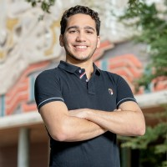
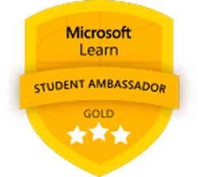
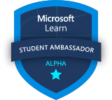
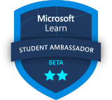
Meet Gold Ambassadors
Humprey Muriungi
Kenya
Gold Milestone
Nawrin Tabassum
Bangladesh
Gold Milestone
Shariff Nasser
Mexico
Gold Milestone
“Joining the community was the best thing that happened to me in my career. It has been an amazing experience which has inspired me to become a force for good and inspire others to achieve more.”
“Being a Student Ambassador gives you the feeling of belonging. It not only helped me learn new skill, but also gain confidence. It allowed me to connect with a diverse group”
“The truth is, you don't have to be an expert. What's important is something we all share: a passion for technology and a passion for our community.”

Slide 6

What to expect
Share your passion and unlock leadership opportunities by creating AI-driven solutions, skilling on cutting-edge AI technology, and building community.
Discover opportunities to become the leader you aspire to be through activities such as:
Building AI-driven solutions
Skilling on cutting-edge AI technology
Sharing your passion and empowering your peers
Collaborating with Microsoft employees
Representing Microsoft Student Ambassadors at events
Your advancement is fueled by completing activities, contributing to the community, and building technical solutions as you unlock additional benefits.

Slide 7




How to register
Students can register for the program throughout the year and new Ambassadors are onboarded quarterly.
Criteria to become a Student Ambassador
Entrepreneurs creating with AI
Community builders
Technology influencers
Authentic agents of change
Must be at least 16 years old at the time of registration | Must be enrolled full-time in an accredited academic institution, e.g. college, university | Not a Microsoft employee or current contractor

Slide 8
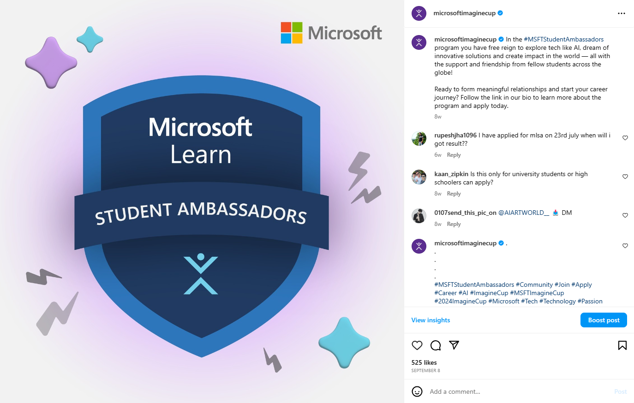
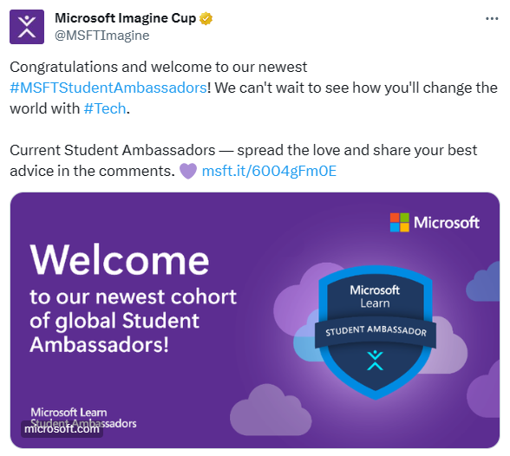
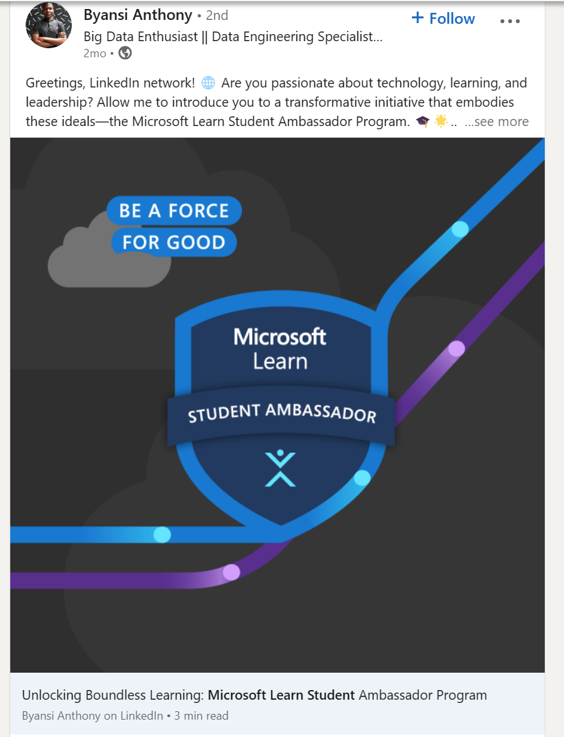

Student Ambassadors Community of social media
#MSFTStudentAmbassadors
@MicrosoftImagineCup
@MSFTImagine
@MSFTImagine

Slide 9


Questions?
Join the Microsoft Learn Student Ambassador LinkedIn group

Slide 10


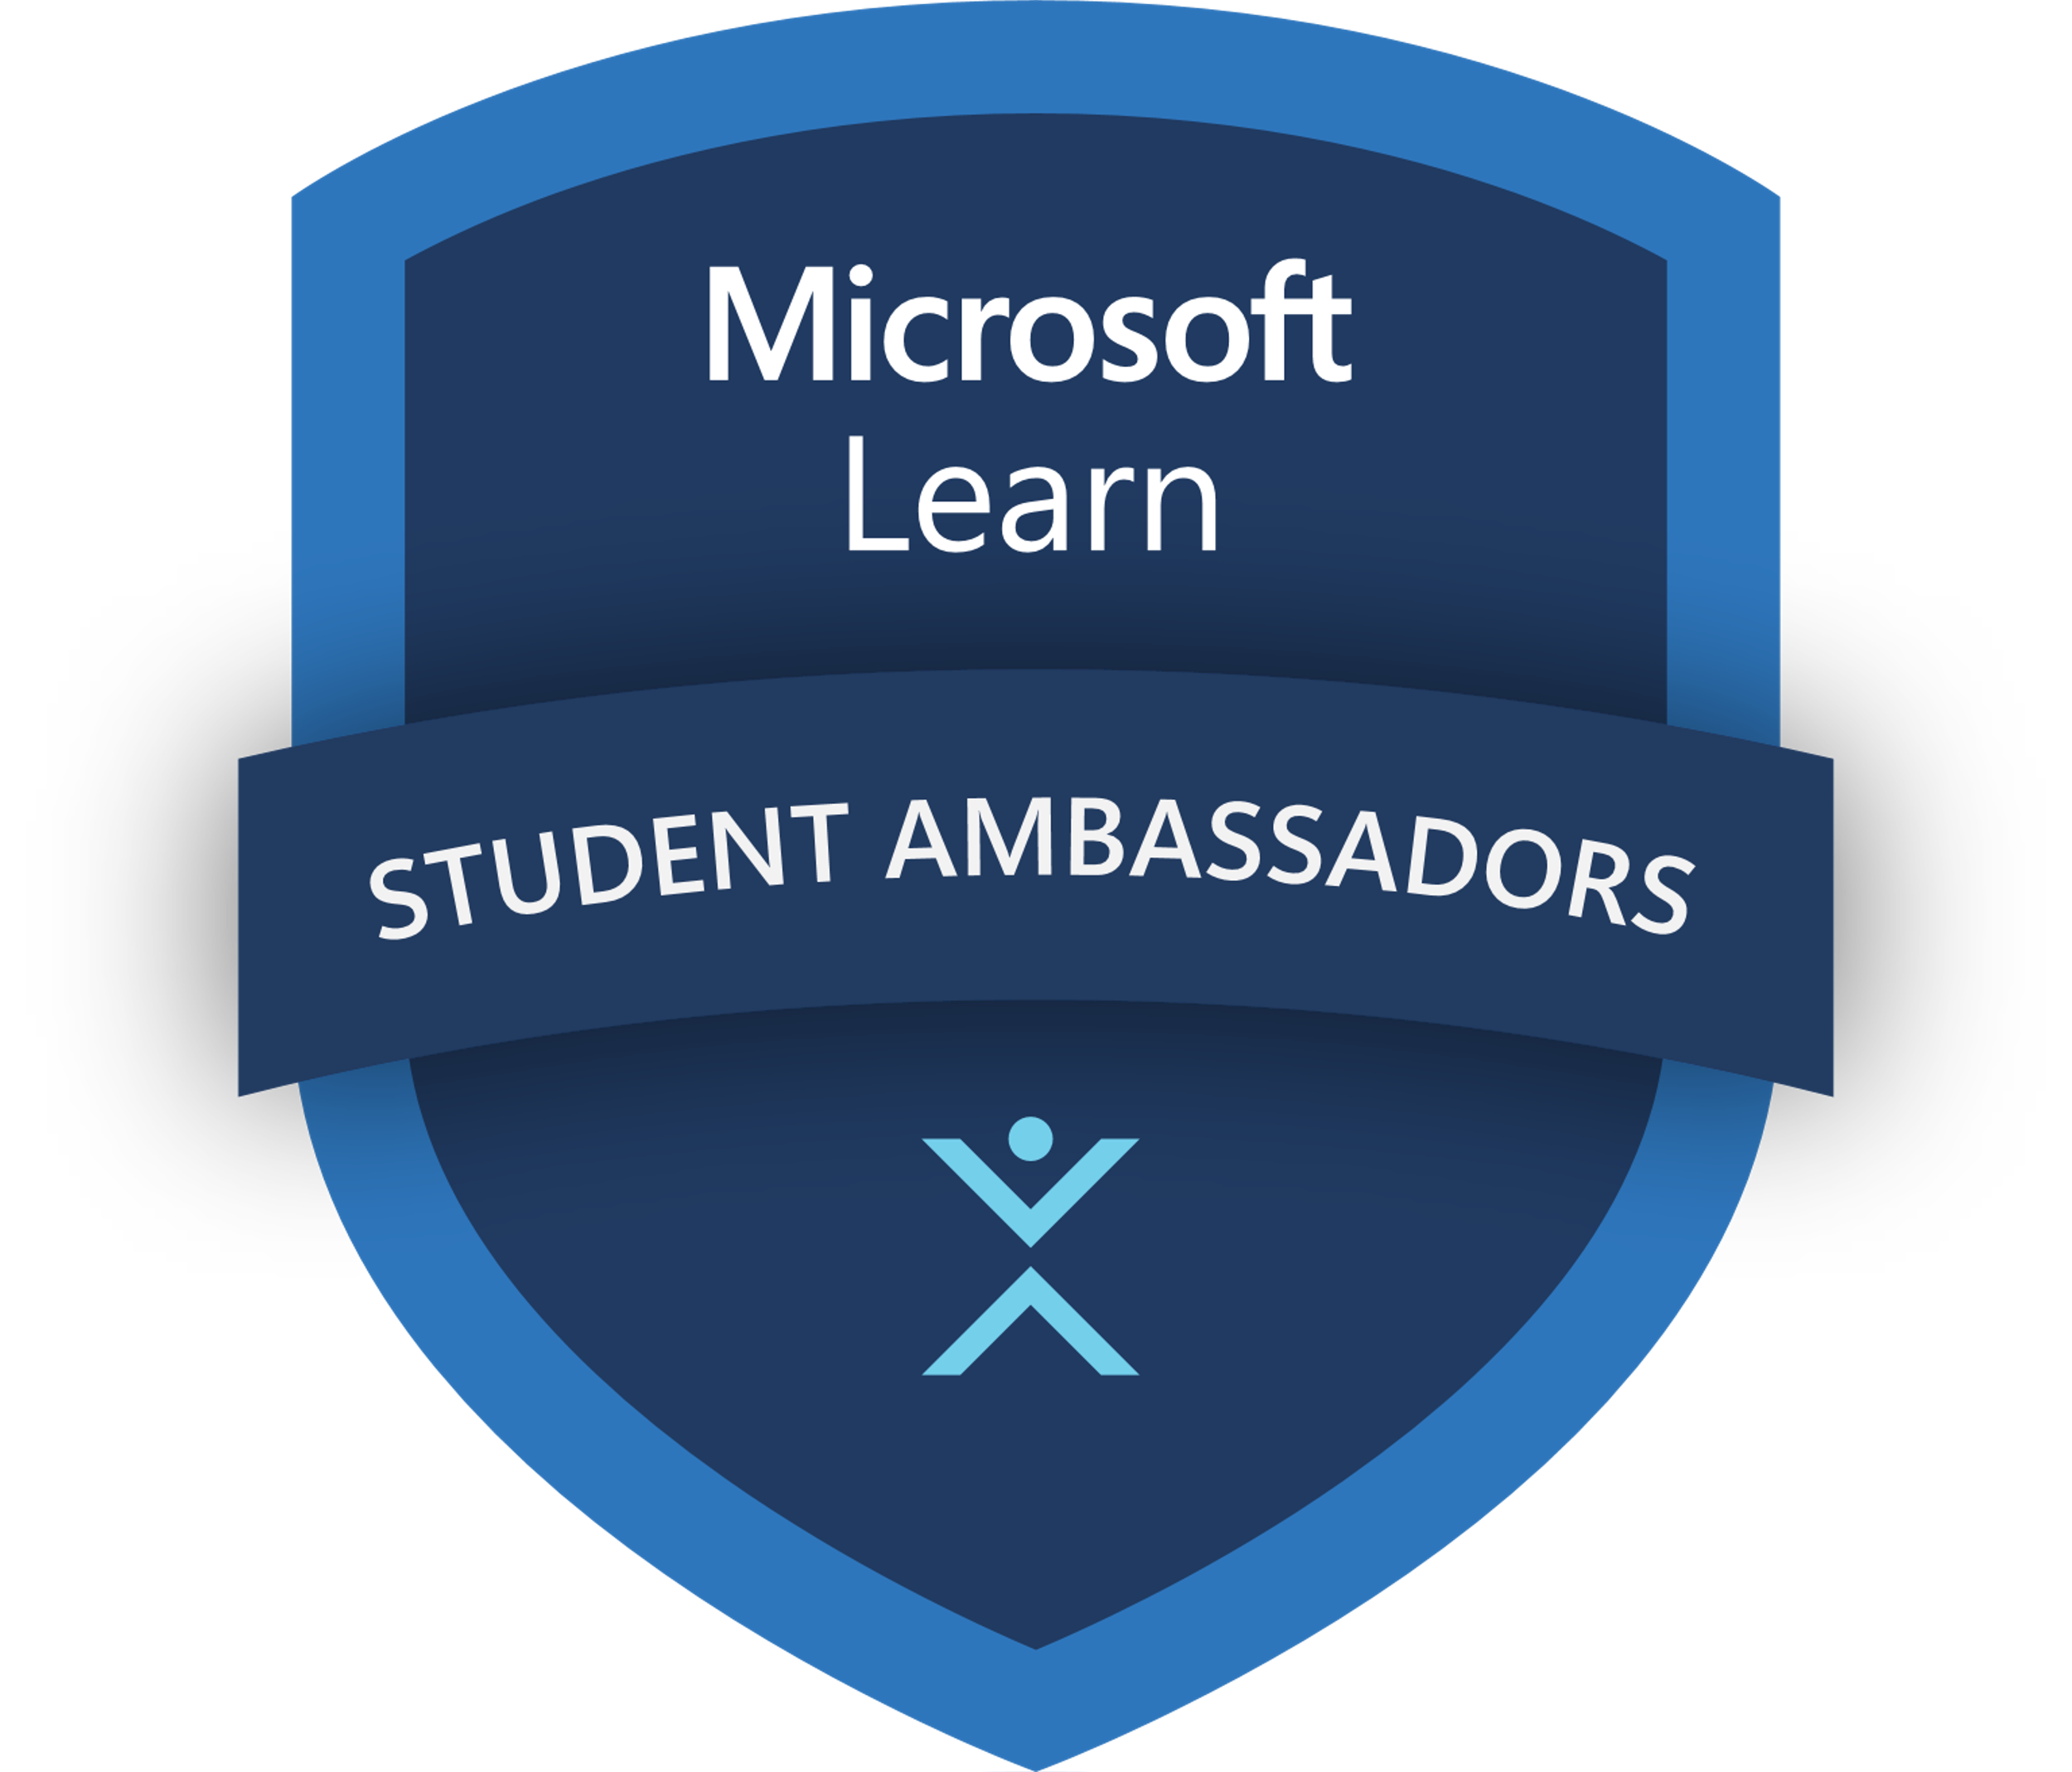







Microsoft Learn Student Ambassadors
The Microsoft Learn Student Ambassadors community brings together passionate students from around the world who are driven to shape the future through building AI-focused startups and solutions, honing their technical and leadership skills, and learning Microsoft technologies to make a positive impact on their communities.
Open to all students globally, with quarterly onboarding
Opportunities to make an impact on socially significant issues
Practical challenges to create AI driven solutions and develop tech, leadership, and career skills
Ready-to-go content kits and tutorials for delivery to fellow students
Exclusive benefits: M365, Azure credit, Visual Studio Enterprise & custom Swag kits
Opportunities to progress and be nominated to become an MVP upon graduation
Free access to training and certifications to enhance employability
Access to Microsoft Cloud Advocates and opportunity to provide product feedback
aka.ms/StudentAmbassadors

